Slide 1
Security in IEEE 802.11 WLANs
INFSCI 1075: Network Security – Spring 2013
Amir Masoumzadeh

Slide 2
Outline
Wireless networks
IEEE 802.11
WEP
Keys
Authentication
Encryption
Attacks
802.11i and WPA
Some Security Solutions

Slide 3
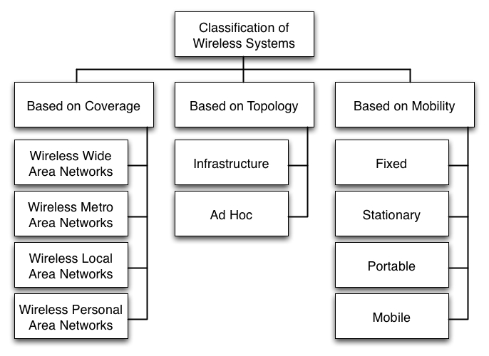
Classification of Wireless Systems

Slide 4
Elements of a Wireless Network
wireless hosts
laptop, PDA, IP phone
run applications
may be stationary (non-mobile) or mobile
wireless does not always mean mobility
network
infrastructure

Slide 5
Elements of a Wireless Network (cont.)
base station
typically connected to wired network
relay - responsible for sending packets between wired network and wireless host(s) in its “area”
e.g., cell towers, 802.11 access points
network
infrastructure

Slide 6
Elements of a Wireless Network (cont.)
wireless link
typically used to connect mobile(s) to base station
also used as backbone link
multiple access protocol coordinates link access
various data rates, transmission distance
network
infrastructure

Slide 7
802.11 LAN Architecture
wireless host communicates with base station
base station = access point (AP)
Basic Service Set (BSS) (aka “cell”) in infrastructure mode contains:
wireless hosts
access point (AP): base station
ad hoc mode: hosts only
Internet
hub, switch
or router
AP
BSS 1
AP
BSS 2

Slide 8
Operational Details
There are two modes of operation of IEEE 802.11
Infrastructure mode
Ad hoc mode
Infrastructure Mode
All communications go through an AP
MS (Mobile Station) to MS communications does not happen
Specifies the BSS or ESS ID or SSID as it is sometimes called
Some systems filter MAC addresses – spoofing is easy
We focus on this mode of operation
Ad hoc mode
MSs communicate with each other in a peer-to-peer manner
MSs do not forward packets
MSs have to be in range of one another in order to communicate

Slide 9
Elements of a Wireless Network (cont.)
infrastructure mode
base station connects mobiles into wired network
handoff: mobile changes base station providing connection into wired network
network
infrastructure

Slide 10
Elements of a Wireless Network (cont.)
ad hoc mode
no base stations
nodes can only transmit to other nodes within link coverage
nodes organize themselves into a network: route among themselves

Slide 11
Terminology
Access Point
Provides access to distribution services via the wireless medium
Basic Service Area (BSA)
The coverage area of one access point
Basic Service Set (BSS)
A set of stations controlled by one access point
Distribution system
The fixed (wired) infrastructure used to connect a set of BSSs to create an extended service set (ESS)
Wired infrastructure
BSA 1
hub, switch
or router
AP
BSS 1
AP
ESS 1

Slide 12
Types of Messages in 802.11
Control messages
Short messages – primarily ACKs
Management messages
Messages between MSs and APs to negotiate set-up
Examples are association request and responses
Carries information about capabilities of the network (data rates, radio parameters, power saving flags, etc.)
Data frames
Actual layer 2 frames transmitted by either the AP or the MS

Slide 13
Management Frames in 802.11
Beacon
Timestamp, beacon interval, capabilities, ESSID, traffic indication map (TIM)
TIM: Contains a list of stations for which unicast data frames are buffered in the access point while they were asleep
Capabilities: data rates, radio parameters, power saving flags, etc.
Probe
ESSID, Capabilities, Supported Rates
Probe Response
Same as beacon except for TIM
Re-association Request
Capability, listen interval, ESSID, supported rates, old AP address
Re-association Response
Capability, status code, station ID, supported rates

Slide 14
Beacons
Beacon
Medium
Busy
Beacon is a message that is transmitted quasi-periodically by the access point
It contains information such as the BSS-ID, timestamp (for synchronization), traffic indication map (for sleep mode), power management, and roaming
Beacons are always transmitted at the expected beacon interval unless the medium is busy
RSS (Received Signal Strength) measurements are made based on the beacon message

Slide 15
Association
To deliver a frame to a MS
The distribution system must know which AP is serving the MS
Association
Procedure by which an MS “registers” with an AP
Only after association can an MS send packets through an AP
How is the association information maintained in the distribution system is NOT specified by the standard

Slide 16
Re-association and Dissociation
The re-association service is used when a MS moves from one BSS to another within the same ESS
It is always initiated by the MS
It enables the distribution system to recognize the fact that the MS has moved its association from one AP to another
The dissociation service is used to terminate an association
It may be invoked by either party to an association (the AP or the MS)
It is a notification and not a request. It cannot be refused
MSs leaving a BSS will send a dissociation message to the AP which need not be always received

Slide 17
Wired Equivalent Privacy (WEP)
Background
The only standard for WLAN security till 2000
Still used by a large number of legacy implementations
Objectives behind WEP
“Reasonable” strength
Intended to make it difficult to break in like a wired network
Self synchronizing
Each frame is encrypted independently of the others
Efficient
It must be fast and in software or hardware
Exportable
There must be no export restriction (1997) – use 40 bit keys
Optional

Slide 18
WEP Keys
Characteristics
Keys are either 40 or 104 bits long and symmetric
Keys are static – they never change unless manually reconfigured
Two types – default and key mapping keys
Default key
All MSs and APs use a single set of keys
Also called shared key, group key, multicast key or simply key by vendors
Possible to have more than one default key (up to 4 values)
The default key in use is called the active key
Directional usage of keys is also possible
Key mapping keys – not widely deployed
Each MS has a unique key (also called per-station or individual key)
AP keeps a table of MSs and keys
Need a separate key for multicast/broadcast messages that is shared by all MSs
Both types of keys can be allowed simultaneously in a WLAN

Slide 19
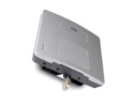
WEP Authentication
Open authentication
AP accepts connections from all MSs
MSs connect to any available AP that is willing to accept a connection
Shared key authentication
Uses a version of the challenge response protocol
There is NO key exchange as part of the protocol
Easy to hijack sessions after authentication is performed if subsequent encryption is not used
Used primarily to eliminate confusion for honest MSs
Most systems do not implement any authentication at all
AP
MS
Authentication Request
Authentication Response
Open Security Authentication
AP
MS
Authentication Request
Authentication Challenge
Authentication Response
Authentication Success
Shared Key Authentication

Slide 20
WEP Authentication - Shared Key
Idea
Allow the AP to know that the MS possesses the right secret key
Process
Host requests authentication from access point
AP sends 128 bit nonce
Host encrypts nonce using shared symmetric key using RC4
AP decrypts nonce and authenticates the host
The authentication is NOT mutual

Slide 21
WEP Confidentiality
Data packets are all encrypted using RC4 stream cipher
You should NOT use the same key with a stream cipher to encrypt two message (why?)
Each packet in IEEE 802.11 is encrypted separately
There is only one key shared between the MS and AP
How can we avoid the problem with stream ciphers?
Idea in WEP
Combine the secret key with a 24-bit Initialization Vector (IV) that changes for every packet
This increases the key size from 40 to 64 bits
Or from 104 to 128 bits
The IV is transmitted in plaintext with each packet making the increase in key size meaningless

Slide 22
WEP Confidentiality (cont.)
64 bit key used to generate stream of keys, k_{i}^{IV}
k_{i}^{IV} used to encrypt i^{th} byte, d_{i}, in frame:
c_{i} = d_{i} XOR k_{i}^{IV}
IV and encrypted bytes c_{i} sent in frame
CRC is used for integrity check

Slide 23
WEP Confidentiality - Weakness
To be effective, the same IV must not be used twice – ever
2²⁴ = 16,777,216
No. of packets/sec at a busy AP = 700
Time taken to capture 2²⁴ packets = 2²⁴/700 = 23968 secs. = 399 mins = 6.65 hours
Many systems
Start with the same IV value after shutting down
Change IVs in a pseudorandom manner that is predictable
Make all MSs start with the same sequence of IVs

Slide 24
Attacks against WEP
Authentication
Useful only if you can prove each time you send a packet that you are a legitimate MS
It allows offline key guessing
Oscar can authenticate himself ANYTIME
No session key is exchanged and subsequent message are not authenticated
The AP is not authenticated – easy for Oscar to mount a man-in-the-middle or reflection attack
Reflection attack?
The attacker initiates a connection to a target.
The target attempts to authenticate the attacker by sending it a challenge.
The attacker opens another connection to the target, and sends the target this challenge as its own.
The target responds to the challenge.
The attacker sends that response back to the target on the original connection.

Slide 25
Attacks against WEP (cont.)
IV Reuse
Collisions in IVs are likely to occur sooner than 2²⁴ packets
If Oscar knows the key stream corresponding to a particular IV, he can also decode all packets with the same IV
Attackers can inject packets to speed up the process
Other weaknesses
WEP has no protection against replay
WEP encrypted messages can be modified easily because the CRC used is linear and encryption is just XOR
If you “flip” a bit of the ciphertext, you can predict which bits in the CRC part need to be flipped as well

Slide 26
Attacks against WEP (cont.)
Weak RC4 keys
Some keys used in RC4 are weak keys
Since the IV is transmitted as a plaintext, it is easy for Oscar to detect a packet that has been encrypted with a weak key
To overcome this problem, it is better to drop the first several bits of the key stream (256 bytes is suggested)
Fluhrer, Mantin and Shamir showed that Oscar can get the first 8 bits of a key with just 60 messages and subsequent bytes in the same way
Attack is linear, not exponential so that longer keys do not help much

Slide 27
Tools to Attack WEP
Airsnort
Implements the FMS attack
http://airsnort.shmoo.com/
Requires a large number of packets (5-10 million or more) to break WEP
Aircrack and Aircrack-ng
http://www.wirelessdefence.org/Contents/AircrackORIGINAL.html
Needs 200K to 500K packets with unique IVs
Needs tuning
http://www.aircrack-ng.org/
Newer versions need about 30K to 50K packets
Gerix (a GUI for aircrack-ng)
https://github.com/TigerSecurity/gerix-wifi-cracker
Included on Backtrack 5 (a Linux-based penetration testing package)
WepLab
http://weplab.sourceforge.net/
Needs tuning but is comparable to Aircrack
Other tools
WEPWedgie, chopchop

Slide 28
Recent Trends in 802.11 Security
Wi-Fi Protected Access (WPA)
Security is based on 802.1x and EAP (Extensible Authentication Protocol)
Allows many protocol within a common framework
Example
Use a RADIUS server
Remote Authentication Dial In User Service (RADIUS) is a networking protocol that provides centralized Authentication, Authorization, and Accounting (AAA) management for computers to connect and use a network service
Authenticate the access point using a variation of SSL
Authenticate the MS using passwords (Challenge-Handshake Authentication Protocol)
Use VPNs (IPsec or SSL)
IEEE has come up with a standard (802.11i)
Use AES instead of RC4 for better security

Slide 29
802.11i and WPA
The IEEE 802.11 Working Group handles standardization of 802.11
They have several task groups that deal with different aspects of the standard
The Task Group “i” deals with security issues
Idea in 802.11i
Authentication and key establishment using higher layers
Follow by a limited-life “security context”
Define a new wireless network called robust security network (RSN)
Allow WEP as well as enhanced security in a transitional security network (TSN)
Wi-Fi Protected Access (WPA)
Subset of RSN that has been currently adopted for legacy systems

Slide 30
Some Security Solutions for Wireless LANs

Slide 31
Physical Solutions
Reduce the wireless signal
Don’t put your access point near a window
Use directional antennas
Limit signal power
Radio shield paint
Window coverings that reduce the wireless signal
Limit physical access to your buildings and specifically your data centers
Monitor property access
Alert your guards to wireless concerns
Utilize CCTV & photo ID
Test your physical security regularly
Notes:
6t

Slide 32
Logical Solutions
Change default names
Add passwords to all devices
Disable broadcasting on network Access Points
Do not give the network a name that identifies your company
Move wireless Access Points away from windows
Disable DHCP
Do not allow remote management of Access Point

Slide 33
Logical Solutions (cont.)
Use the built-in encryption
Disable the features you don't use
Upgrade your firmware
Put a firewall between the wireless network and other company computers
Encrypt data
Change all default settings for Access Point
Such as IP Address
Regularly test wireless network security

Slide 34
Solutions Provided by APs
Closed-System ESSIDs
Removes ESSID from beacon frames
Requires clients to have correct ESSID for association (essentially a shared authentication password)
But ESSID can still be found in management frames regarding reassociation
MAC filtering
Can be easily bypassed
Script filtering
Limit the available protocols and use higher layers’ security services
e.g., HTTPS, and S/MIME

Slide 35
Intermediate WLAN
11-100 users
Can use MAC addresses, WEP and rotate keys if you want.
Some vendors have limited MAC storage ability
SLAN also an option
Another solution is to tunnel traffic through a VPN

Slide 36
VPN
Provides a scalable authentication and encryption solution
Does require end user configuration and a strong knowledge of VPN technology
Users must re-authenticate if roaming between VPN servers

Slide 37
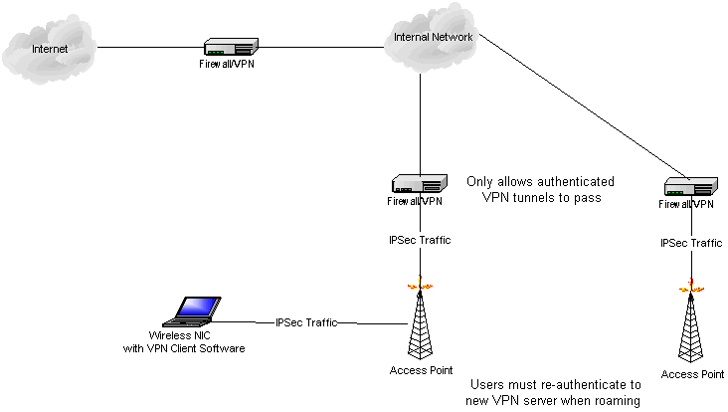
VPN Architecture

Slide 38
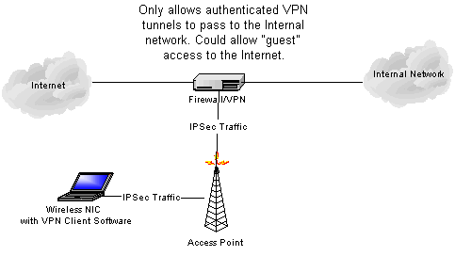
VPN Architecture

Slide 39
Enterprise WLAN
100+ users
Reconfiguring WEP keys not feasible
Multiple access points and subnets
Possible solutions include VLANs, VPNs, custom solutions, and 802.1x

Slide 40
VLANs
Combine wireless networks on one VLAN segment, even geographically separated networks.
Use 802.1Q VLAN tagging to create a wireless subnet and a VPN gateway for authentication and encryption

Slide 41
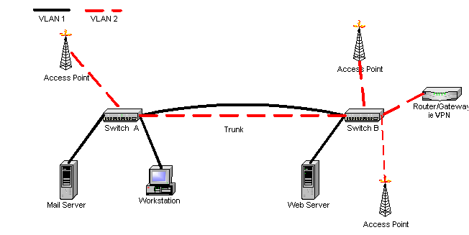
VLAN Architecture

